Slide 1
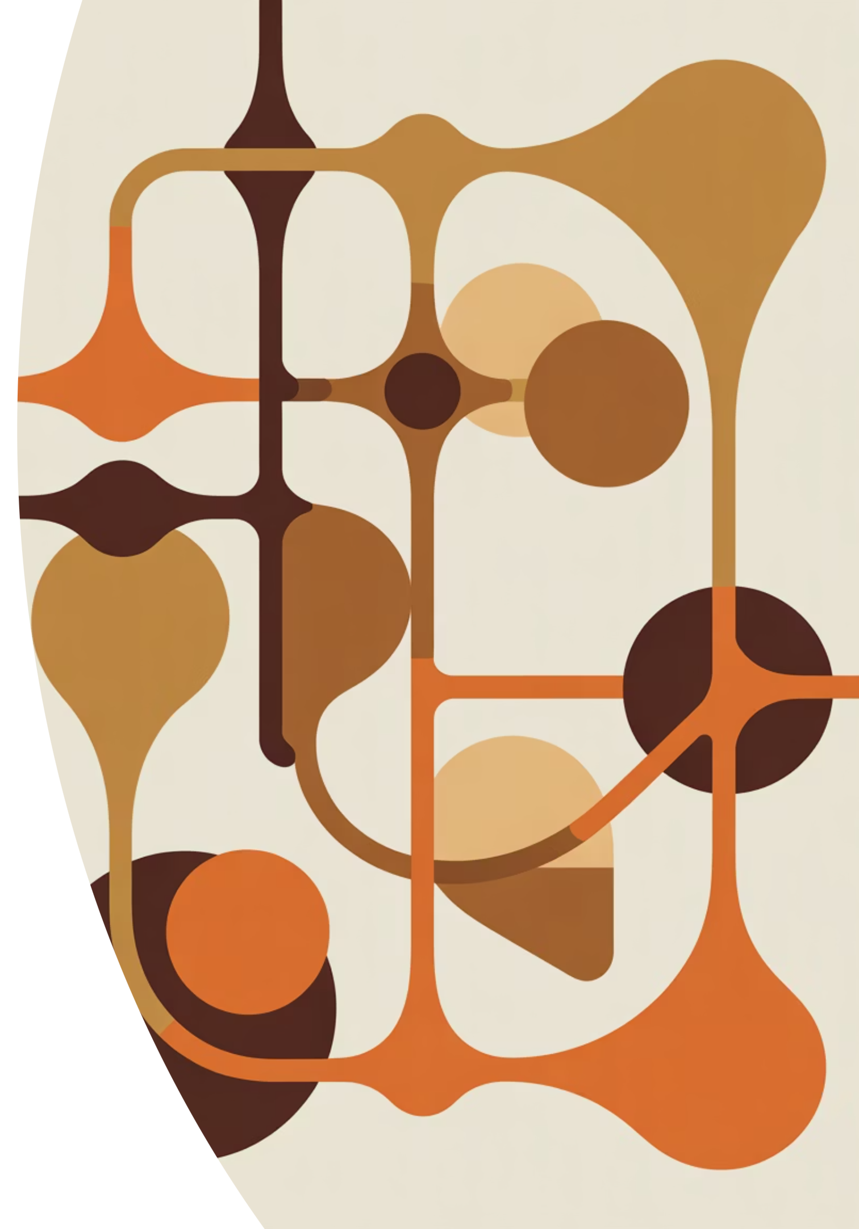
Understanding K-Nearest Neighbors
A visual journey into one of machine learning's most intuitive algorithms — where prediction emerges from the wisdom of nearby neighbors.

Slide 2
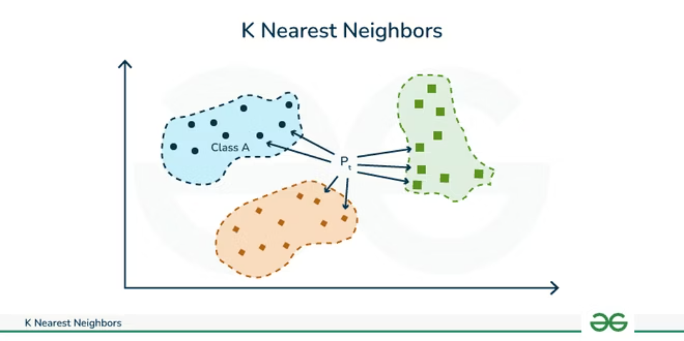
The Core Idea of KNN
K-Nearest Neighbors predicts new data points by looking at the closest known examples. The algorithm measures distance in the feature space to identify which existing points are "nearest" to the query point.
Think of it like asking your neighbors for recommendations — you trust those closest to you because they're in a similar situation.

Slide 3
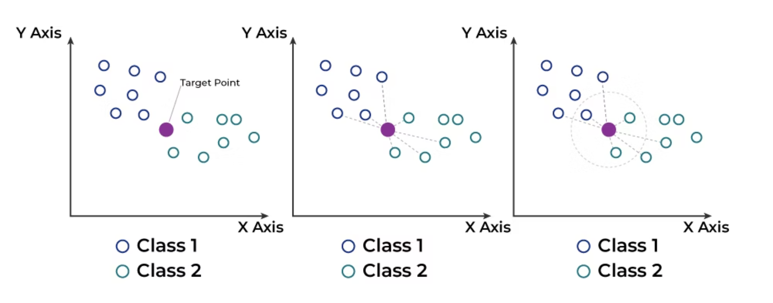
KNN for Classification
01
02
03
Find K Nearest Neighbors
Count Class Votes
Assign Majority Class
Identify the K closest data points to the query using distance calculation
Each neighbor casts a vote for its class label
The query point receives the class with the most votes
In classification tasks, KNN operates like a democratic election where nearby neighbors vote to determine the class of an unknown point.

Slide 4
KNN for Regression
Making Numeric Predictions
42
38
For regression problems, KNN doesn't vote — it averages. The algorithm finds the K nearest neighbors and computes the mean of their numeric values.
Neighbor 1
Neighbor 2
This approach smooths out predictions by incorporating information from multiple similar examples, reducing the impact of outliers.
45
41.7
Neighbor 3
Prediction
Average value

Slide 5

Why KNN Is Called a Lazy Learner
Training Phase
Prediction Phase
No model building
Calculates all distances
No parameter optimization
Sorts neighbors
Just stores the dataset
Aggregates results
Zero computation
All the work happens here
Unlike eager learners that build models during training, KNN delays all computation until prediction time. This makes training instant but prediction potentially slower.

Slide 6



What Controls KNN Behavior
Distance Metric
Value of K
Feature Scaling
How we measure "nearness" between points — Euclidean, Manhattan, or other distance functions shape the neighborhood geometry.
The number of neighbors to consider — small K captures local patterns but risks noise; large K provides stability but may over-smooth.
Normalizing feature ranges ensures no single dimension dominates distance calculations — critical for fair comparison across different units.

Slide 7
Key Intuition
Your answer depends on who your neighbors are
Sparse Neighborhood
Dense Neighborhood
Different context leads to different predictions
Same point, different answer based on local environment
KNN's elegance lies in its simplicity: predictions emerge naturally from local structure. The algorithm's behavior is entirely determined by the training data and the choice of K — no complex optimization required.

